Slide 1


Time Series Analysis and Forecasting: An Introduction
Muhammad Akmal Farouqi
08/5/2024
www.ugm.ac.id
Locally Rooted, Globally Respected

Slide 2
Random Walk & Stasionaritas

Slide 3
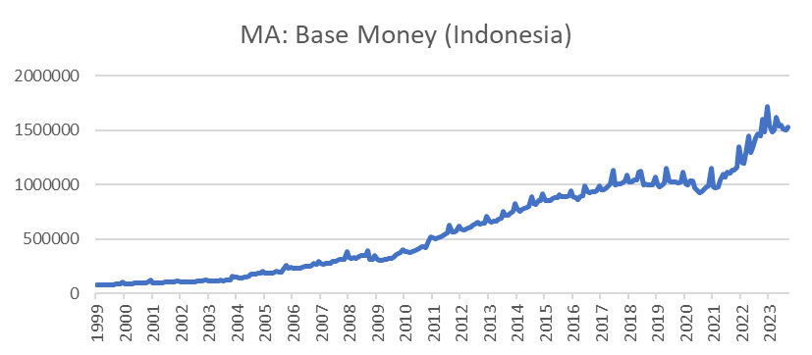


Understanding Time Series Data
A time series is a collection of data points gathered over a period of time and ordered chronologically
Time-series data composed by components below:
Trend = reflecting long-term growth, that is persistence
Seasonal = reflecting seasonal variance that has fix pattern on each period over time
Cyclical = non-periodic recurring fluctuations
Irregular Component = sometimes called “noise” on period t, is a random and irregular representing component besides the discussed above.
These components might have different characteristics:
Time series econometrics’ goal is to find best model to explain the data generating process (DGP)
Additive
$$y_{t}=T_{t}+C_{t}+S_{t}+I_{t}$$
Multiplicative
$$y_{t}=T_{t}×C_{t}×S_{t}×I_{t}$$

Slide 4

Autoregressive (AR) and Moving Average (MA) Model
Many models invented in order to explain DGP on any types of time series data. In this case, we will cover two basic models.
AR
AR model is model explains that value of $X$ in period $t$ formed by its own value on and error $e$ in period $t$
$$X_{t}=β_{1}X_{t−1}+β_{2}Y_{t−2}+…+β_{p}Y_{t−p}+ε_{t}$$
Therefore, AR model can be notated as AR(p) where p is number of lag included
MA
MA model explains that $X_{t}$ is not only affected by $e$ in period $t$ but also by the lags of $e$ $(t−i)$
$$X_{t}=μ+ε_{t}+\sum_{i−1}^{q}{γ_{i}e_{t−i}}$$

Slide 5
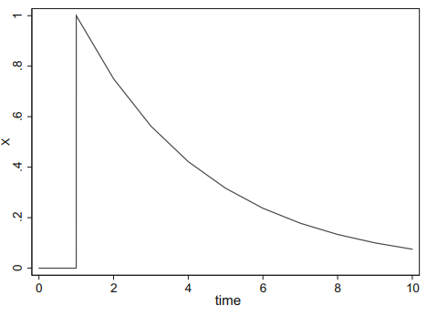

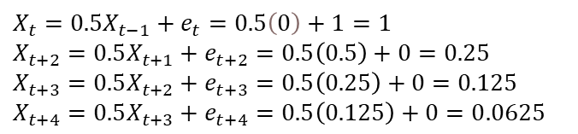

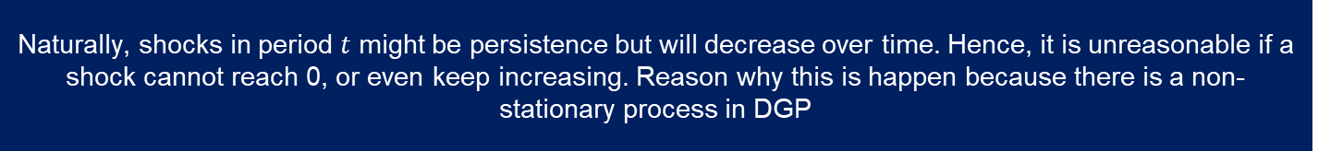
Impulse Response Function
The IRF gives the $j^{th}$-period response when the system is shocked by a one-standard-deviation shock.
For example, an AR(1) simulated with 1 unit shock in $e$
$$X_{t}=0.5X_{t−1}+e_{t}$$
$X_{t}=0.5X_{t−1}+e_{t}=0.5\left(0\right)+1=1$
$X_{t+2}=0.5X_{t+1}+e_{t+2}=0.5\left(0.5\right)+0=0.25$
$X_{t+3}=0.5X_{t+2}+e_{t+3}=0.5\left(0.25\right)+0=0.125$
$X_{t+4}=0.5X_{t+3}+e_{t+4}=0.5\left(0.125\right)+0=0.0625$
Eventually, shock’s impact diminish and value of $X$ will reach 0
Naturally, shocks in period $t$ might be persistence but will decrease over time. Hence, it is unreasonable if a shock cannot reach 0, or even keep increasing. Reason why this is happen because there is a non-stationary process in DGP

Slide 6

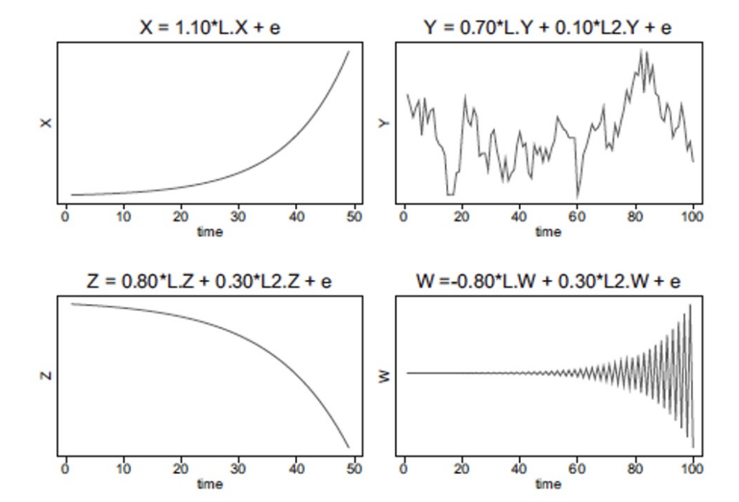



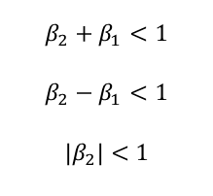

Stationarity
Some analyses require data to be stationary. Estimating non-stationary data would result in spurious regression, and causes by the variable’s non-essential component, especially trend, are also included. Time series data is considered stationary if the mean, variance, and autocovariance are not affected by a specific period of time.
Mean Stationary
Stationarity in AR(p)
$$X_{t}=β_{1}X_{t−1}+β_{2}X_{t−2}+e_{t}$$
Variance Stationary
Should comply these conditions
$$β_{2}+β_{1}<1$$
$$β_{2}−β_{1}<1$$
$$\left|β_{2}\right|<1$$
Covariance Stationary

Slide 7


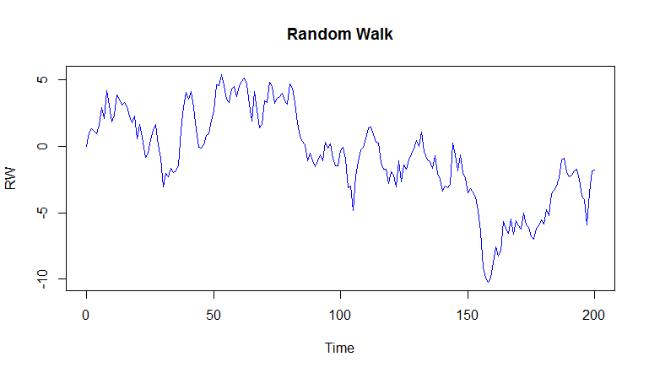
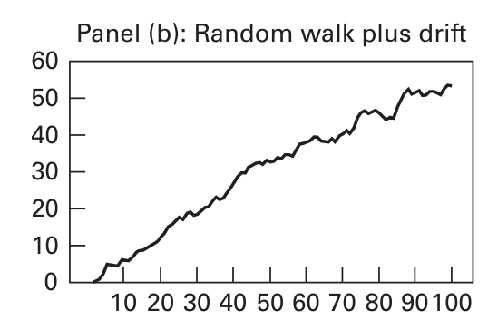
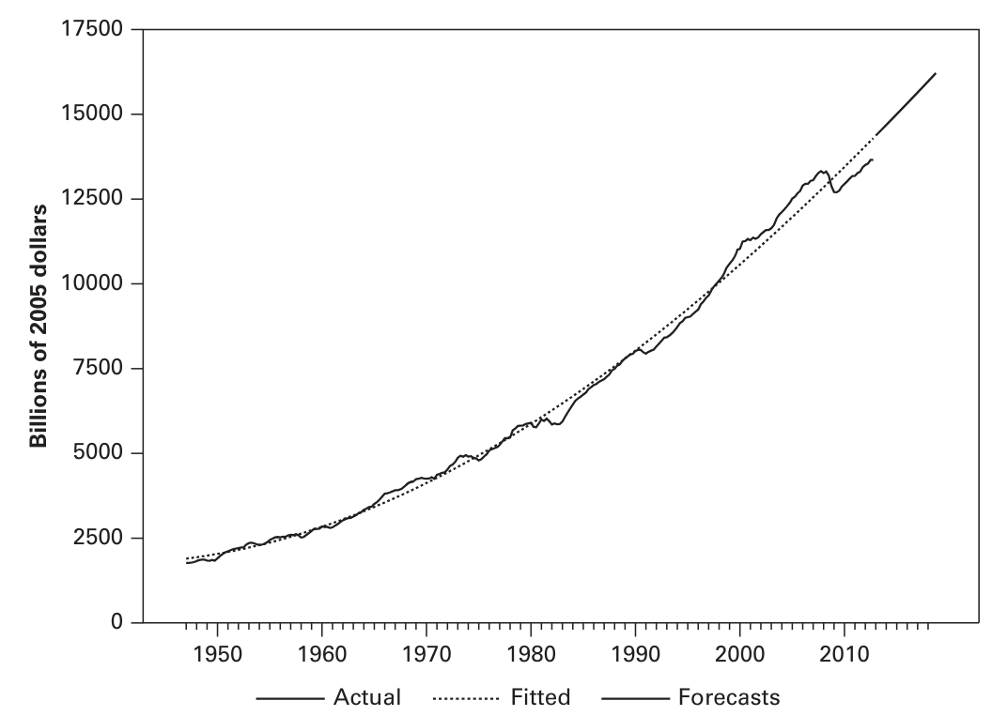

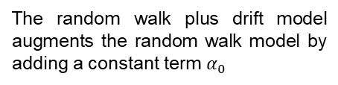
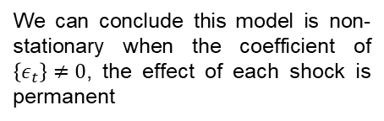
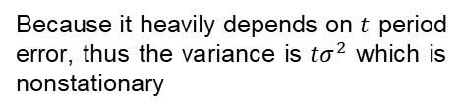
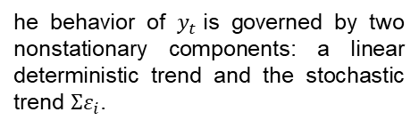
Nonstationary Processes
In reality, we often find some data that are not fulfilling the stationary conditions. These nonstationary processes categorized below:
Random walk
Random walk with drift
Deterministic trend model
A data identified as a random walk when $α_{0}=0$
The random walk plus drift model augments the random walk model by adding a constant term $α_{0}$
Deterministic trend model includes two main variables; constant and trend
Because it heavily depends on $t$ period error, thus the variance is $tσ^{2}$ which is nonstationary
he behavior of $y_{t}$is governed by two nonstationary components: a linear deterministic trend and the stochastic trend $Σε_{i}$.
We can conclude this model is non-stationary when the coefficient of $\left\{ε_{t}\right\}≠0$, the effect of each shock is permanent

Slide 8
Unit Root

Slide 9
Unit roots
In the presence of nonstationary variables, there might be what Granger and Newbold (1974) call a spurious regression. A spurious regression has high $R^{2}$ and $t$-statistics that appear to be significant, but the results don’t have any economic meaning.
Definition
Unit roots represent a specific type of non-stationarity. Technically, roots that lie on the unit circle are right that marks the transition from stationary.
Several most used unit root tests
(tests with null hypothesis of unit roots)
+ Dickey-Fuller (DF)
+ Augmented Dickey-Fuller (ADF)
+ Dickey-Fuller GLS (DF-GLS)
+ Phillips-Perron
+ KPSS
These tests can be used to know whether our data is stationary or not. However, in case we find our data is non-stationary there are a few approaches that are different for each type of non-stationary process.

Slide 10
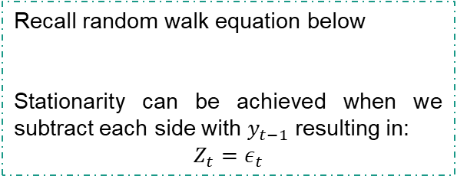
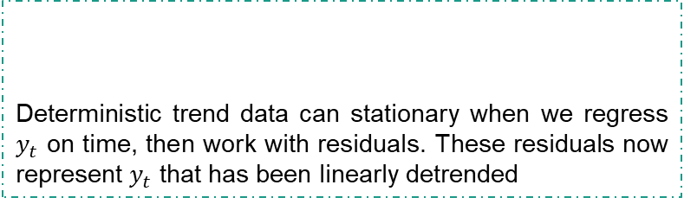
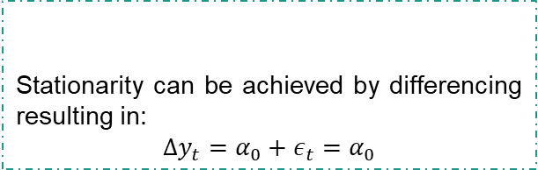
Treating non-stationary data process
Random Walk
Deterministic Trend
Recall random walk equation below
Stationarity can be achieved when we subtract each side with $y_{t−1}$ resulting in:
$$Z_{t}=ε_{t}$$
Deterministic trend data can stationary when we regress $y_{t}$ on time, then work with residuals. These residuals now represent $y_{t}$ that has been linearly detrended
Random Walk With Drift
For ARMA, we can treat the data using those approaches. But, if we decide to use first differencing the model will named ARIMA
Stationarity can be achieved by differencing resulting in:
$$∆y_{t}=α_{0}+ε_{t}=α_{0}$$

Slide 11
Smoothing & Forecasting

Slide 12

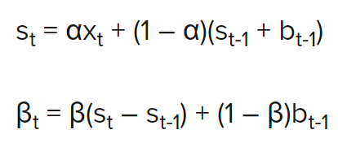
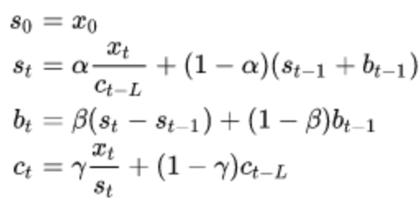
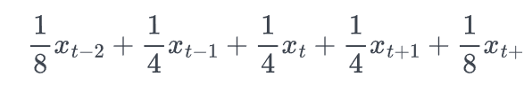
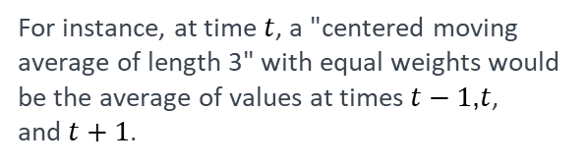
Smoothing
Smoothing is usually done to help us better see patterns, trends for example, in time series. Generally smooth out the irregular roughness to see a clearer signal. Smoothing doesn’t provide us with a model, but it can be a good first step in describing various components of the series.
Moving Average
Exponential Smoothing
At each point in time, we determine averages of observed values that surround a particular time.
This method produces forecasts that are weighted averages of past observations where the weights of older observations exponentially decrease
For instance, at time $t$, a "centered moving average of length 3" with equal weights would be the average of values at times $t−1$,$t$, and $t+1$.
SES: assumes that the time series has no trend or seasonality.
To smooth away seasonality in quarterly data, in order to identify trend, the usual convention is to use the moving average smoothed at time 𝑡 is
Holt’s linear: used to forecast time series data that has a linear trend but no seasonal pattern
Holt-Winters’: used to forecast time series data that has both trend and seasonal components
Notes:
Source: https://online.stat.psu.edu/stat510/lesson/5/5.2
https://www.influxdata.com/blog/exponential-smoothing-beginners-guide/

Slide 13
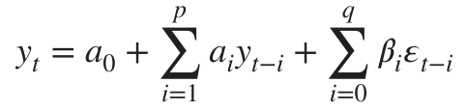
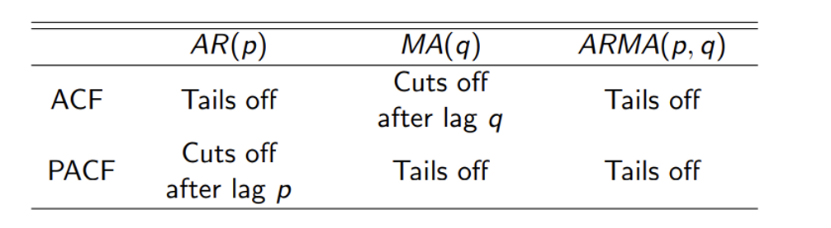
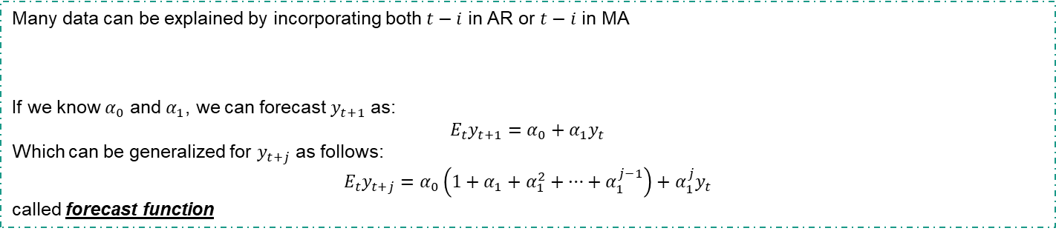
Forecasting
Perhaps the most important use of an ARMA model is to forecast future values of the$\{y_{t}\}$ sequence.
ARMA(p,q)
Many data can be explained by incorporating both $t−i$ in AR or $t−i$ in MA
If we know $α_{0}$ and $α_{1}$, we can forecast $y_{t+1}$ as:
$$E_{t}y_{t+1}=α_{0}+α_{1}y_{t}$$
Which can be generalized for $y_{t+j}$ as follows:
$$E_{t}y_{t+j}=α_{0}\left(1+α_{1}+α_{1}^{2}+…+α_{1}^{j−1}\right)+α_{1}^{j}y_{t}$$
called forecast function
Deciding the best lag
Use the autocorrelation function (ACF) to identify which lags have significant correlations.
PACF is similar to the ACF except that it displays only the correlation between two observations that the shorter lags between those observations do not explain

Slide 14
Thank You

